Slide 1

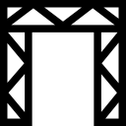

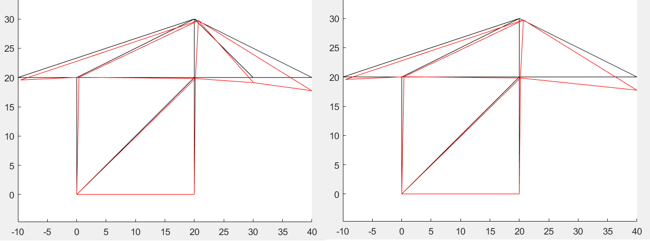


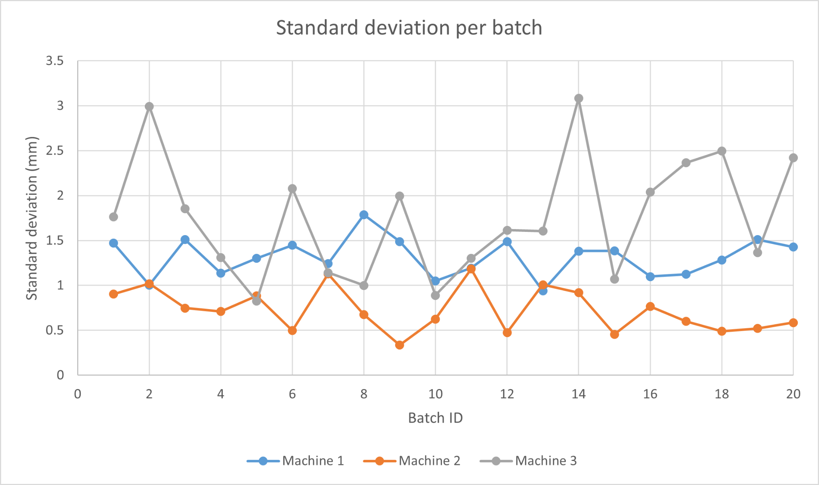
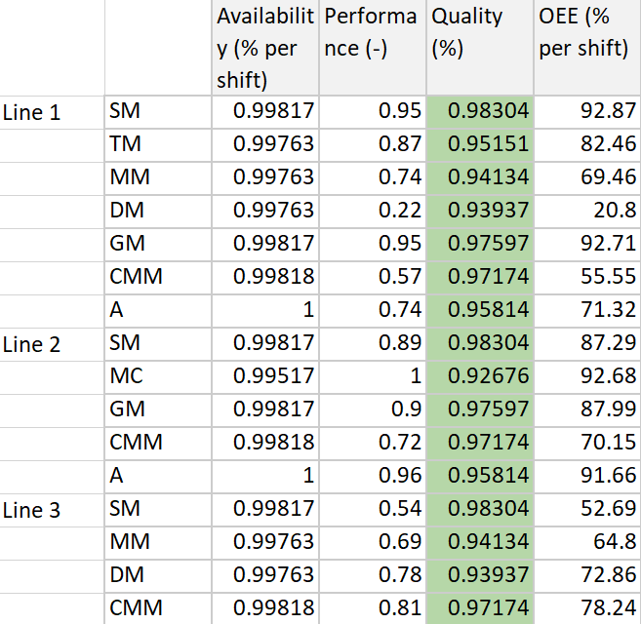
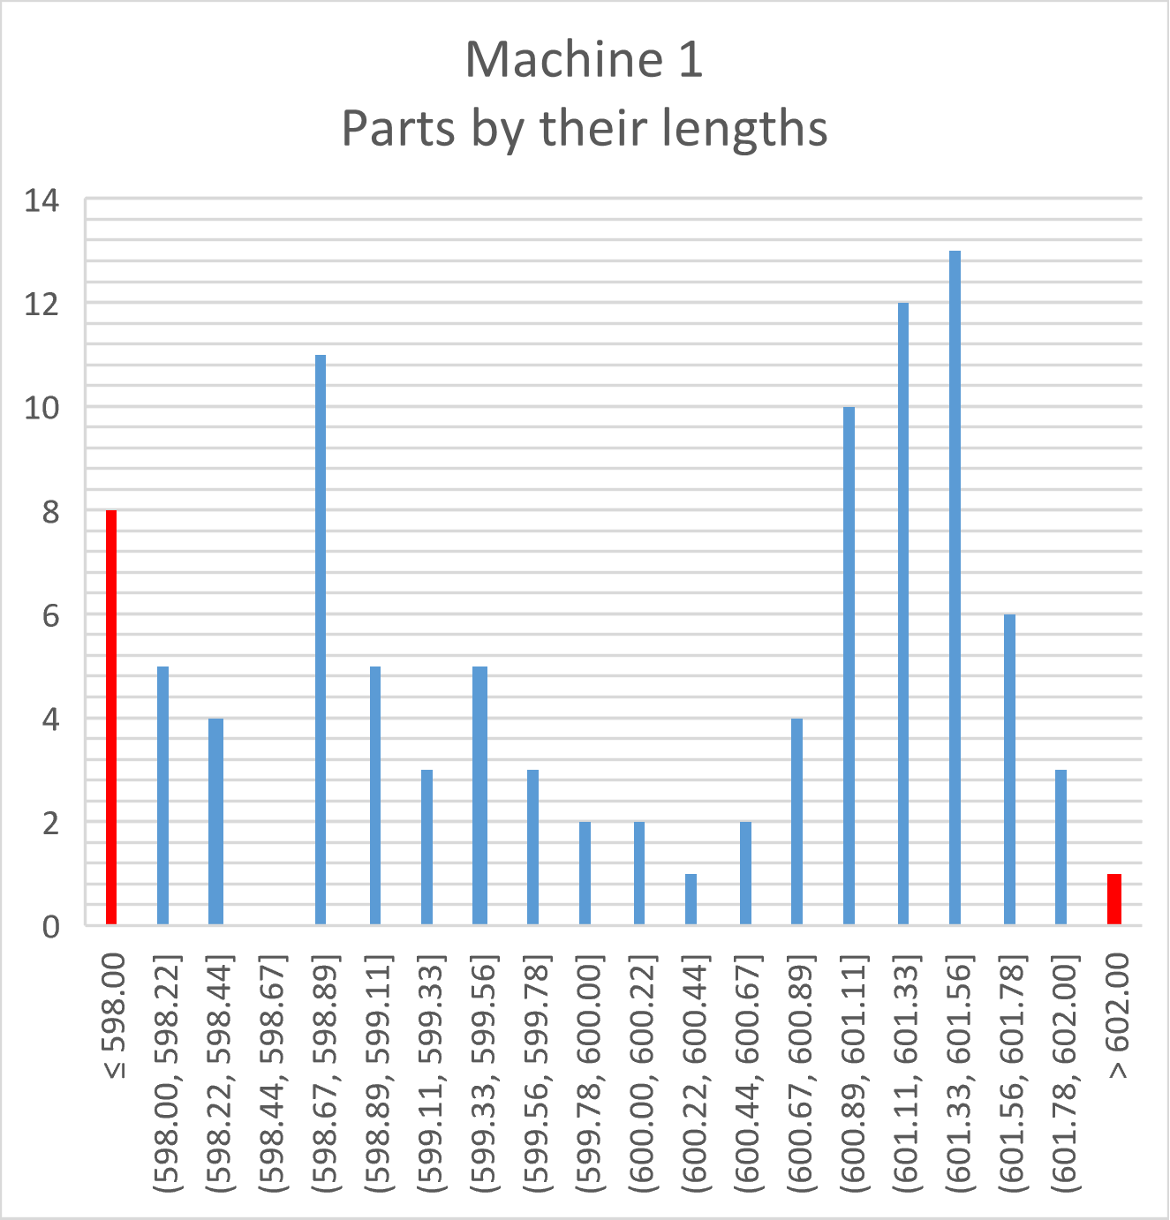
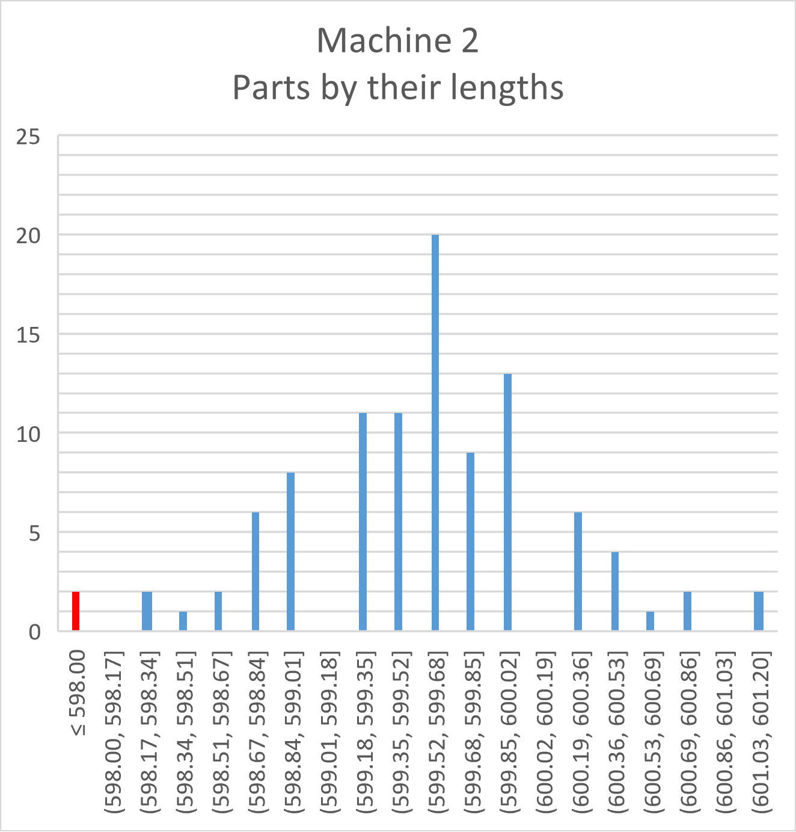
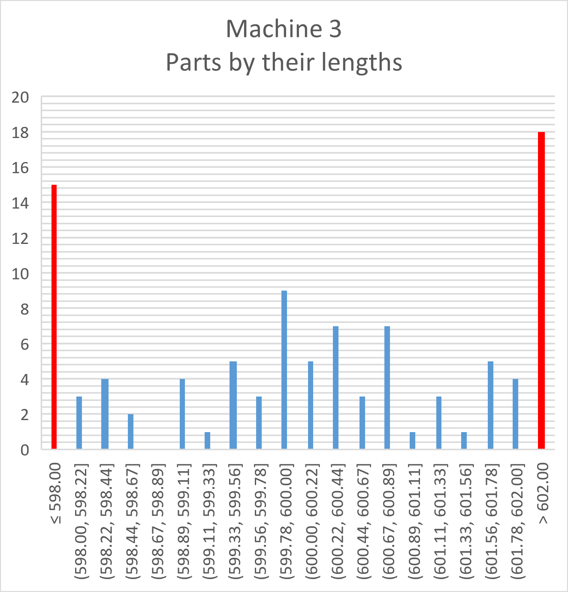

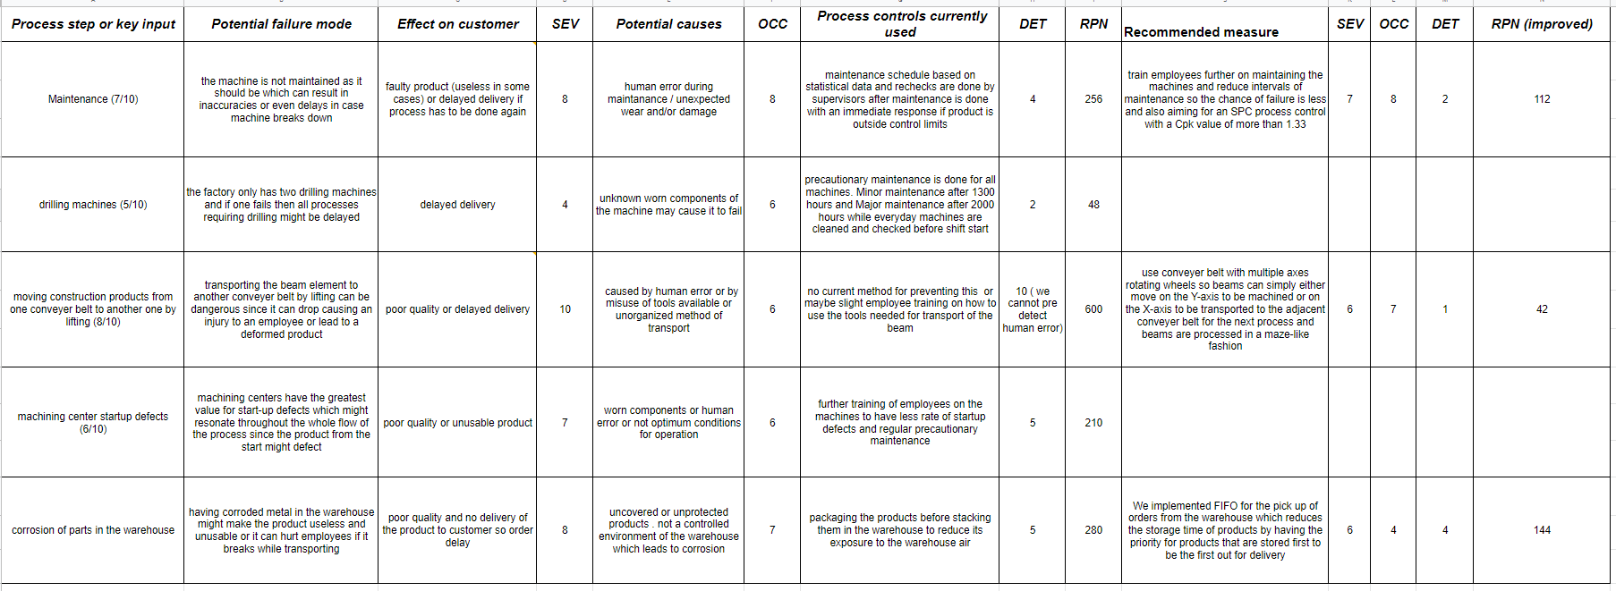
Quality Control & Risk Mitigation
Martijn Bos
Jaap Janssen
Youssef Kamel
FEM Analysis
Subsystem Requirements
Priority performance parameters
Quality (being right )
Dependability ( delivery on time)
From the 5 performance parameters we decided to priorities these parameters over the others. This is based on Etone’s preferred preferences because customer satisfaction is of top priority to them.Based on that, the subsystem’s requirements are defined as follows.
Requirements:
Maintain quality standards of the product
Maintain machinery (maintenance & defects )
Risk management
Our first requirement is analysing the quality of our product and maximize it for optimum customer satisfaction and enhancing production reputation of Eton. This requirement is fulfilled under section quality control. As for the second requirement which is slightly dependent on the first one which focuses on optimizing a maintenance schedule in order to maintain the quality target set for our products, this requirement is discussed further under section Maintenance strategy. For the third requirement we analyze risks in our system in the form of an FMEA analysis, this is shown in section FMEA analysis.
 | Possible crane setup
Properties | Complete crane | Removing element 12 | Removing element 13
Deformation at the tip [mm] (x-direction) | -2.00 | -36.56 | -2.00
Deformation at the tip [mm] (y-direction) | -225.63 | -3.58e+16 | -225.63
Highest occurring Stress [MPa] | 232.92 | 218.54 | 232.92
The FEM analysis of the crane was done with two goals in mind.The first goal is to make sure that the values for the highest occurring stress does not exceed the yield stress so there is no plastic deformation in the STS crane. The second goal was to analyze if any of the elements are not necessary or crucial for the structural integrity of the crane. In the first figure you can see that when element 13 was removed the structure’s deformation was not affected therefore element 13 is the element we chose to eliminate since deformation is still within our safety margin of 4mm. The values for the highest occurring stress in the second figure does not exceed the yield stress of the material used for the cranes therefore we can conclude that no plastic deformation will occur. For this analysis ANSYS was the program used for simulation.
Maintenance Strategy
Quality Control
Based on quality control on the lathes, less time between preventive maintenance may be needed to achieve lower scrap rates and thus a higher quality rate. Another option is to use smart maintenance equipment to achieve optimal maintenance schedules. For now we stick to a time based maintenance of 1300 and 3900 hours for minor and major preventive maintenance respectively.
 | Efficiency (%) | σ_{AVERAGE} (mm) | C_{p} (-) | C_{pk} (-)
Machine 1 | 95 | 1.31 | 0.51 | 0.49
Machine 2 | 99 | 0.73 | 0.92 | 0.71
Machine 3 | 71 | 1.76 | 0.38 | 0.34
FMEA Analysis
References: [1] Systems Design and Engineering - G. Maarten Bonnema, Karel Th. Veenvliet, Jan F. Broenink
[2] A3 Architecture overviews: A tool for effective communication in product evolution - P. Daniel Borches
[3] http://www.a3ao.eu/
[4] https://esi.nl/research/output/methods/a3-system-overview
[5]FMEA (Failure Mode and Effects Analysis) Quick Guide", iSixSigma, 2022. [Online]
UNIVERSITY OF TWENTE.

